Slide 1

Statistical plots
Lesson 5 Hands - On

Slide 2
Instructions
The built in data set rivers has the length in miles of 141 major rivers in north America. You can build a data frame of this data set that is suitable for graphing as follows:
Rr = data.frame(rivers)
With the entire data set, create a histogram with suitable bin widths, a box plot, and a normal probability plot
Are there any outliers in this data set? Are they high or low outliers?
Do these Data appear to come from a normal distribution?

Slide 3
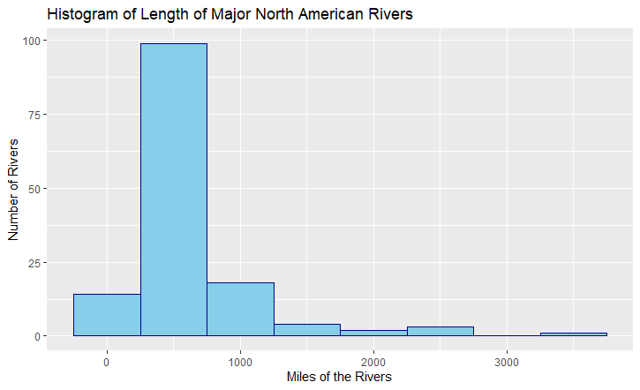
Histogram
Along the x-axis are the measures of the length of the North American Rivers in miles. Along the y-axis of the graph exists the number of major North American rivers whose lengths were measured.
rr = data.frame(rivers)
m <- ggplot(rr, aes(x = rivers))
m + geom_histogram(binwidth = 500, color = "dark blue", fill = "sky blue") + ggtitle("Histogram of Length of Major North American Rivers") + xlab("Miles of the Rivers") + ylab("Number of Rivers")

Slide 4
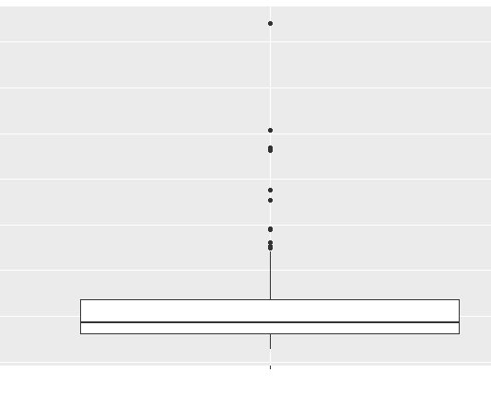
Box Plot
This box plot measures the length in miles of the major North American rivers that exist. The Inter-Quartile Range is 370 with an outlier range of 555, which is quite large. The 3rd quartile added to the outlier range produces 1,235 while the outlier range subtracted from the 1st quartile produces -245. The outliers are quite high.
Code:
summary(rivers)
IQR <- 680 - 310
Outlier_Range <- IQR * 1.5
680 + Outlier_Range
310 - Outlier_Range
rivers_boxplot <- ggplot(rr, aes(x=" ", y = rivers))
rivers_boxplot + geom_boxplot() + xlab(" ")

Slide 5
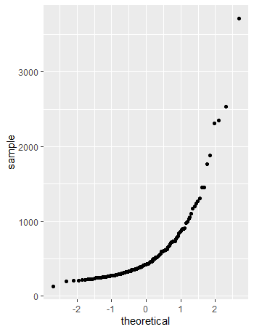
Normal Probability Plot
When applying the “fat pencil test” it appears that most of the data points align along the pencil. After examination, it appears as though the data does come from a normal distribution or is normally distributed.
ggplot(rr, aes(sample = rivers)) + geom_qq()

